Slide 1
Slide website
SIMEDIC.CO.ID
Ikuti perubahan sesuai warna baik teks atau pun asset
(untuk asset dipisahkan filenya)
LINK Preview template: https://www.demos.machothemes.com/medzone-lite/

Slide 2
HOME

Slide 3






GANTI LOGO SIMEDIC
Diganti logo Simedic Service:
Ganti teks: Software Company For Future Health Service Innovations
GANTI BACKGROUND ASSET
Diganti jadi: Hi, We help medical corporate such as clinic, hospital, and many more to scale up by providing them with our signature software namely Simedic

Slide 4
Diganti jadi: Our History
Diganti jadi: Our Services

Slide 5

Teksnya copas diganti ini: Judul: Watch our impact in the patient's life
Deskripsi: We are a a full-service for software and driver lab connections With single integrations system, more than 30 healt services like hospital, klinik, and a national class medical, we provide innovative, technologically advanced care on a patient-friendly.
Button link diarahkan ke: mailto:karyahadejun@gmail.com
Ganti asset

Slide 6
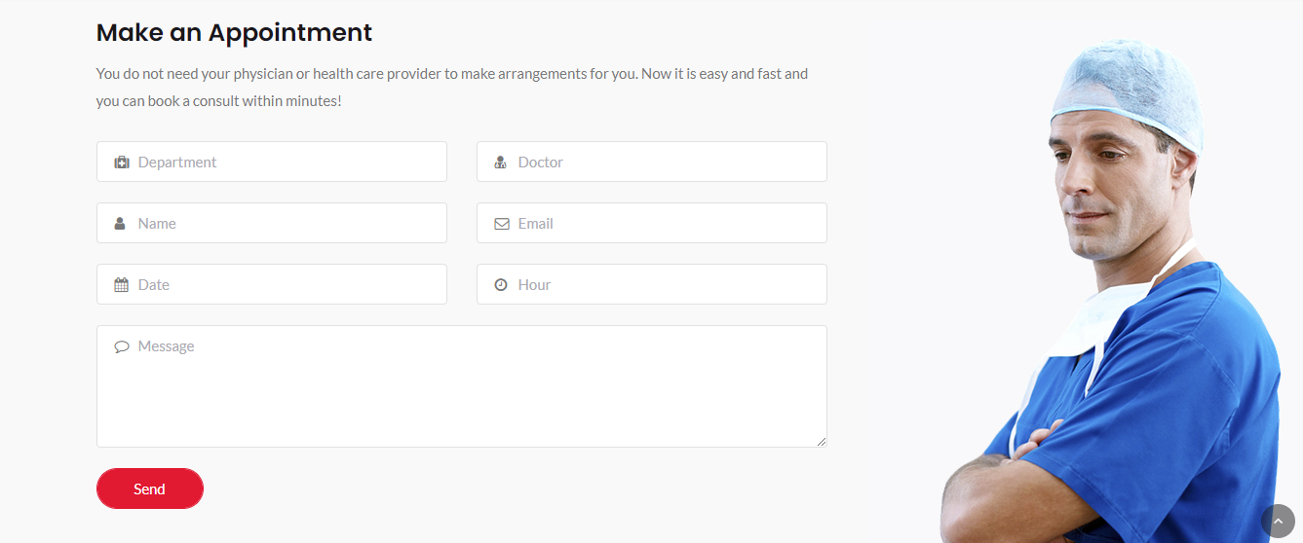
HALAMAN INI DIHIDE MUNCUL KETIKA ORANG KETIK MENU CONTACT. Datanya dikirim ke email: karyahadejun@gmail.com

Slide 7
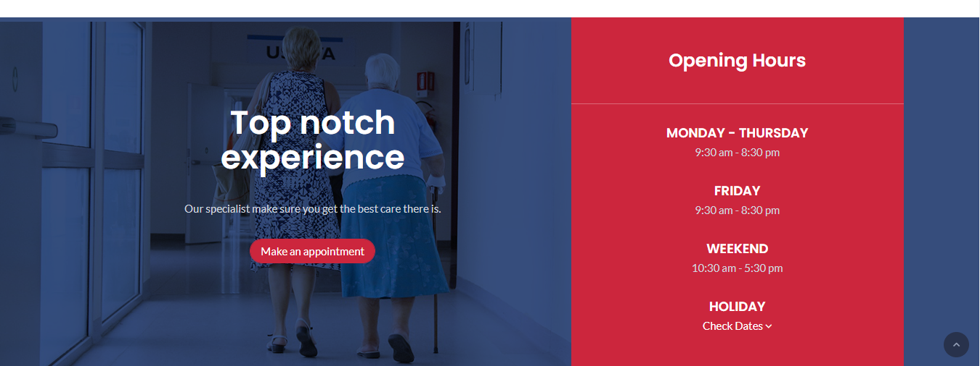
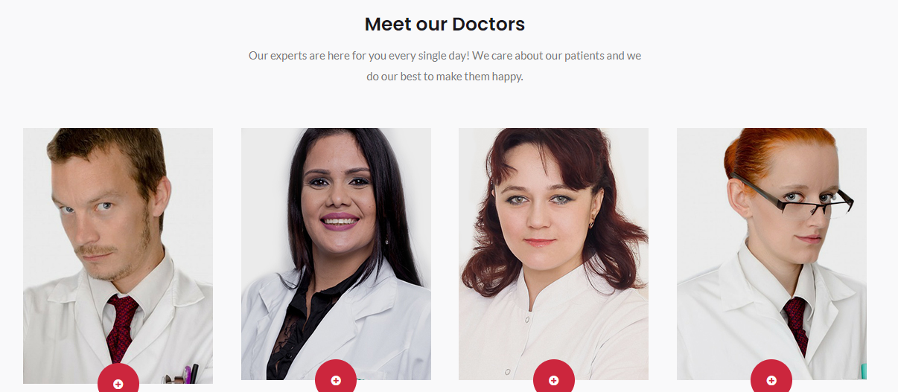
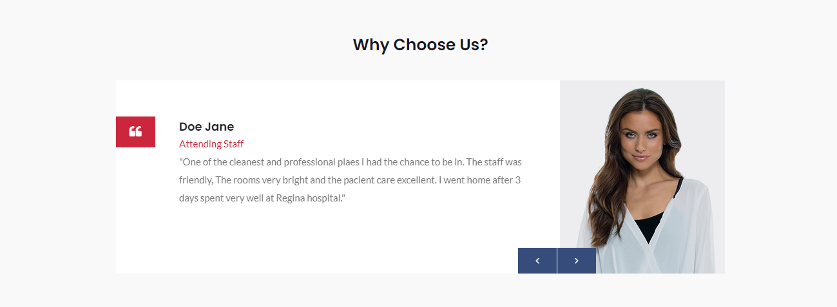
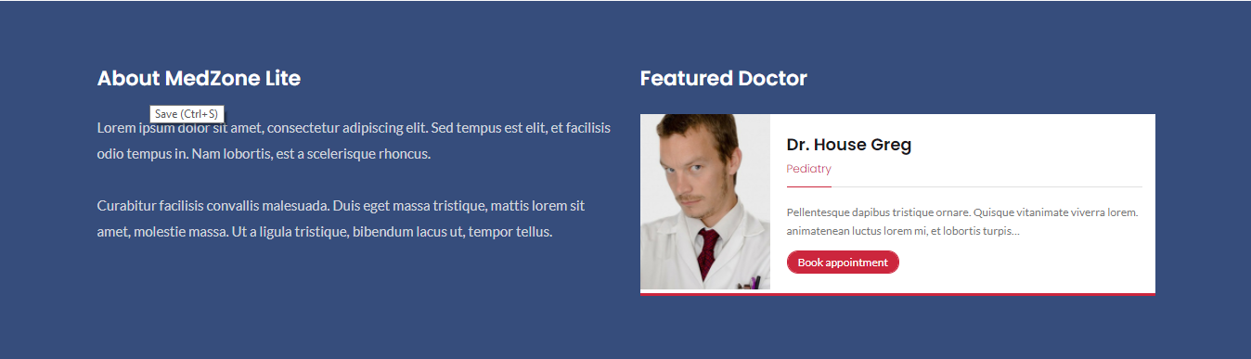
DITAKE OUT DIGANTI OUR PRODUCT

Slide 8
02
Our Product

Slide 9

A Simedic Is future for health services

Slide 10
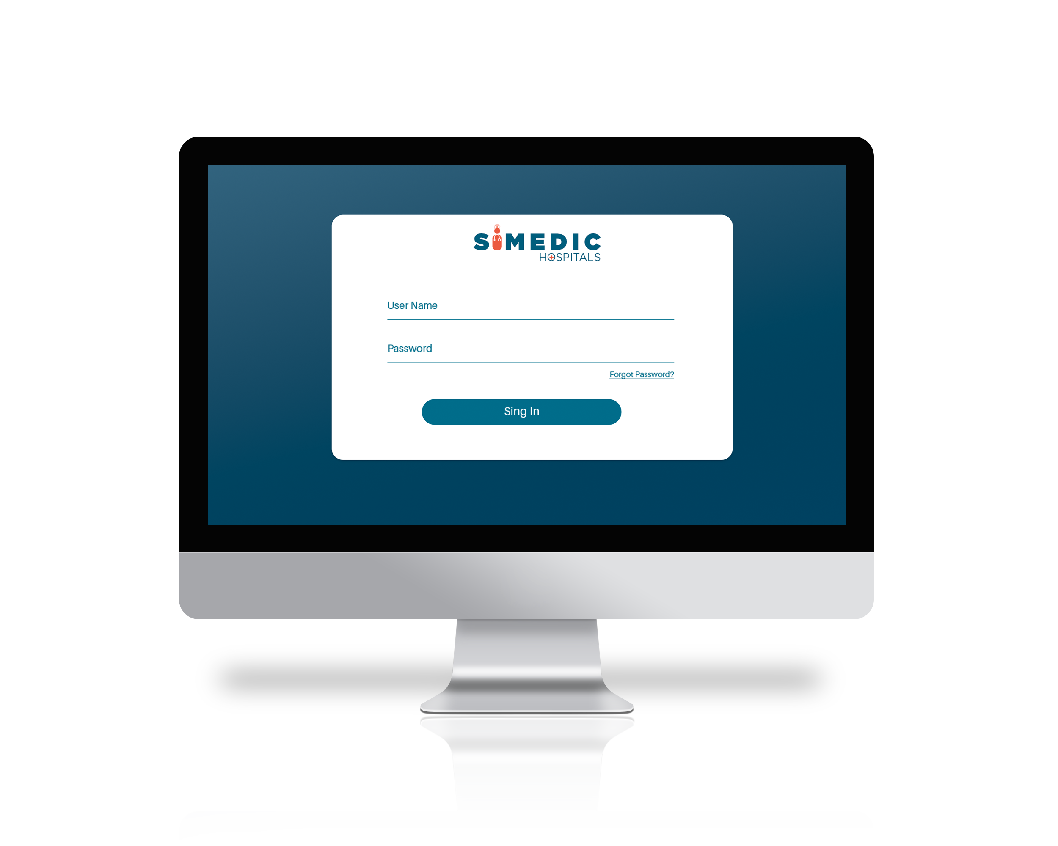
SIMEDIC HOSPITAL
Known as SIM-RS Hadejun innovated the software into SIMEDIC-HOSPITAL with renewable technology making this software easy and light to use for Hospital resources

Slide 11
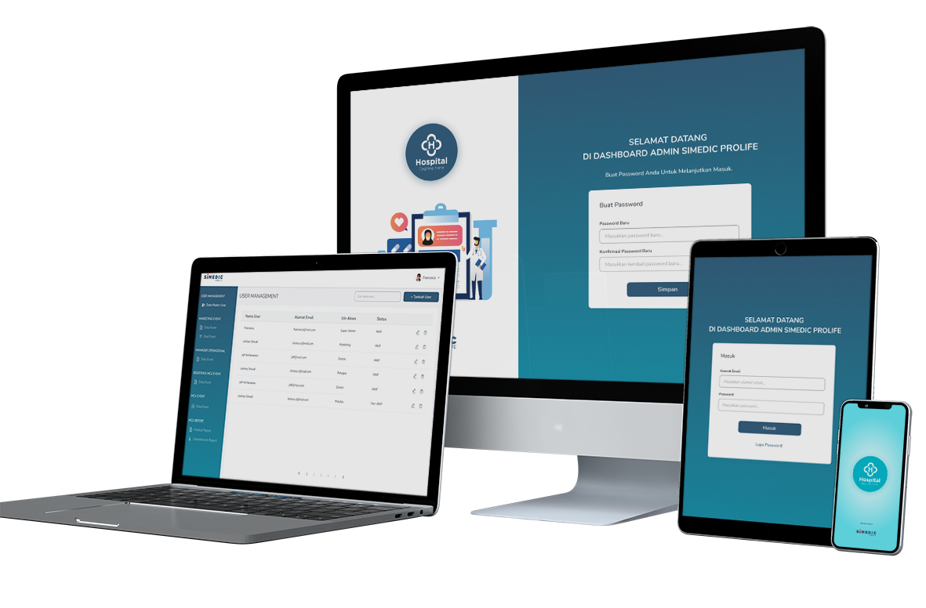
SIMEDIC PROLIFE
The Original MCU’s Digital Innovations with One Time Integrations between klien, doctor, operational, and management

Slide 12
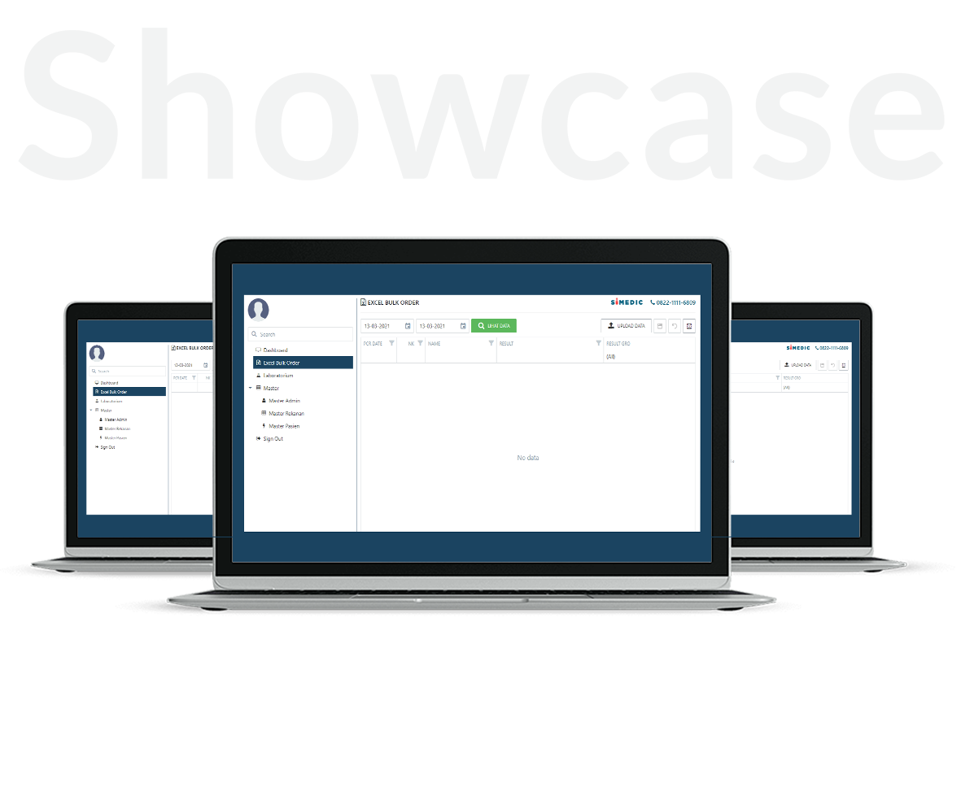
SIMEDIC KLINIK
The System Informations & Management for klinik build with new interface. More fresh, easy to use, and user friendly.

Slide 13
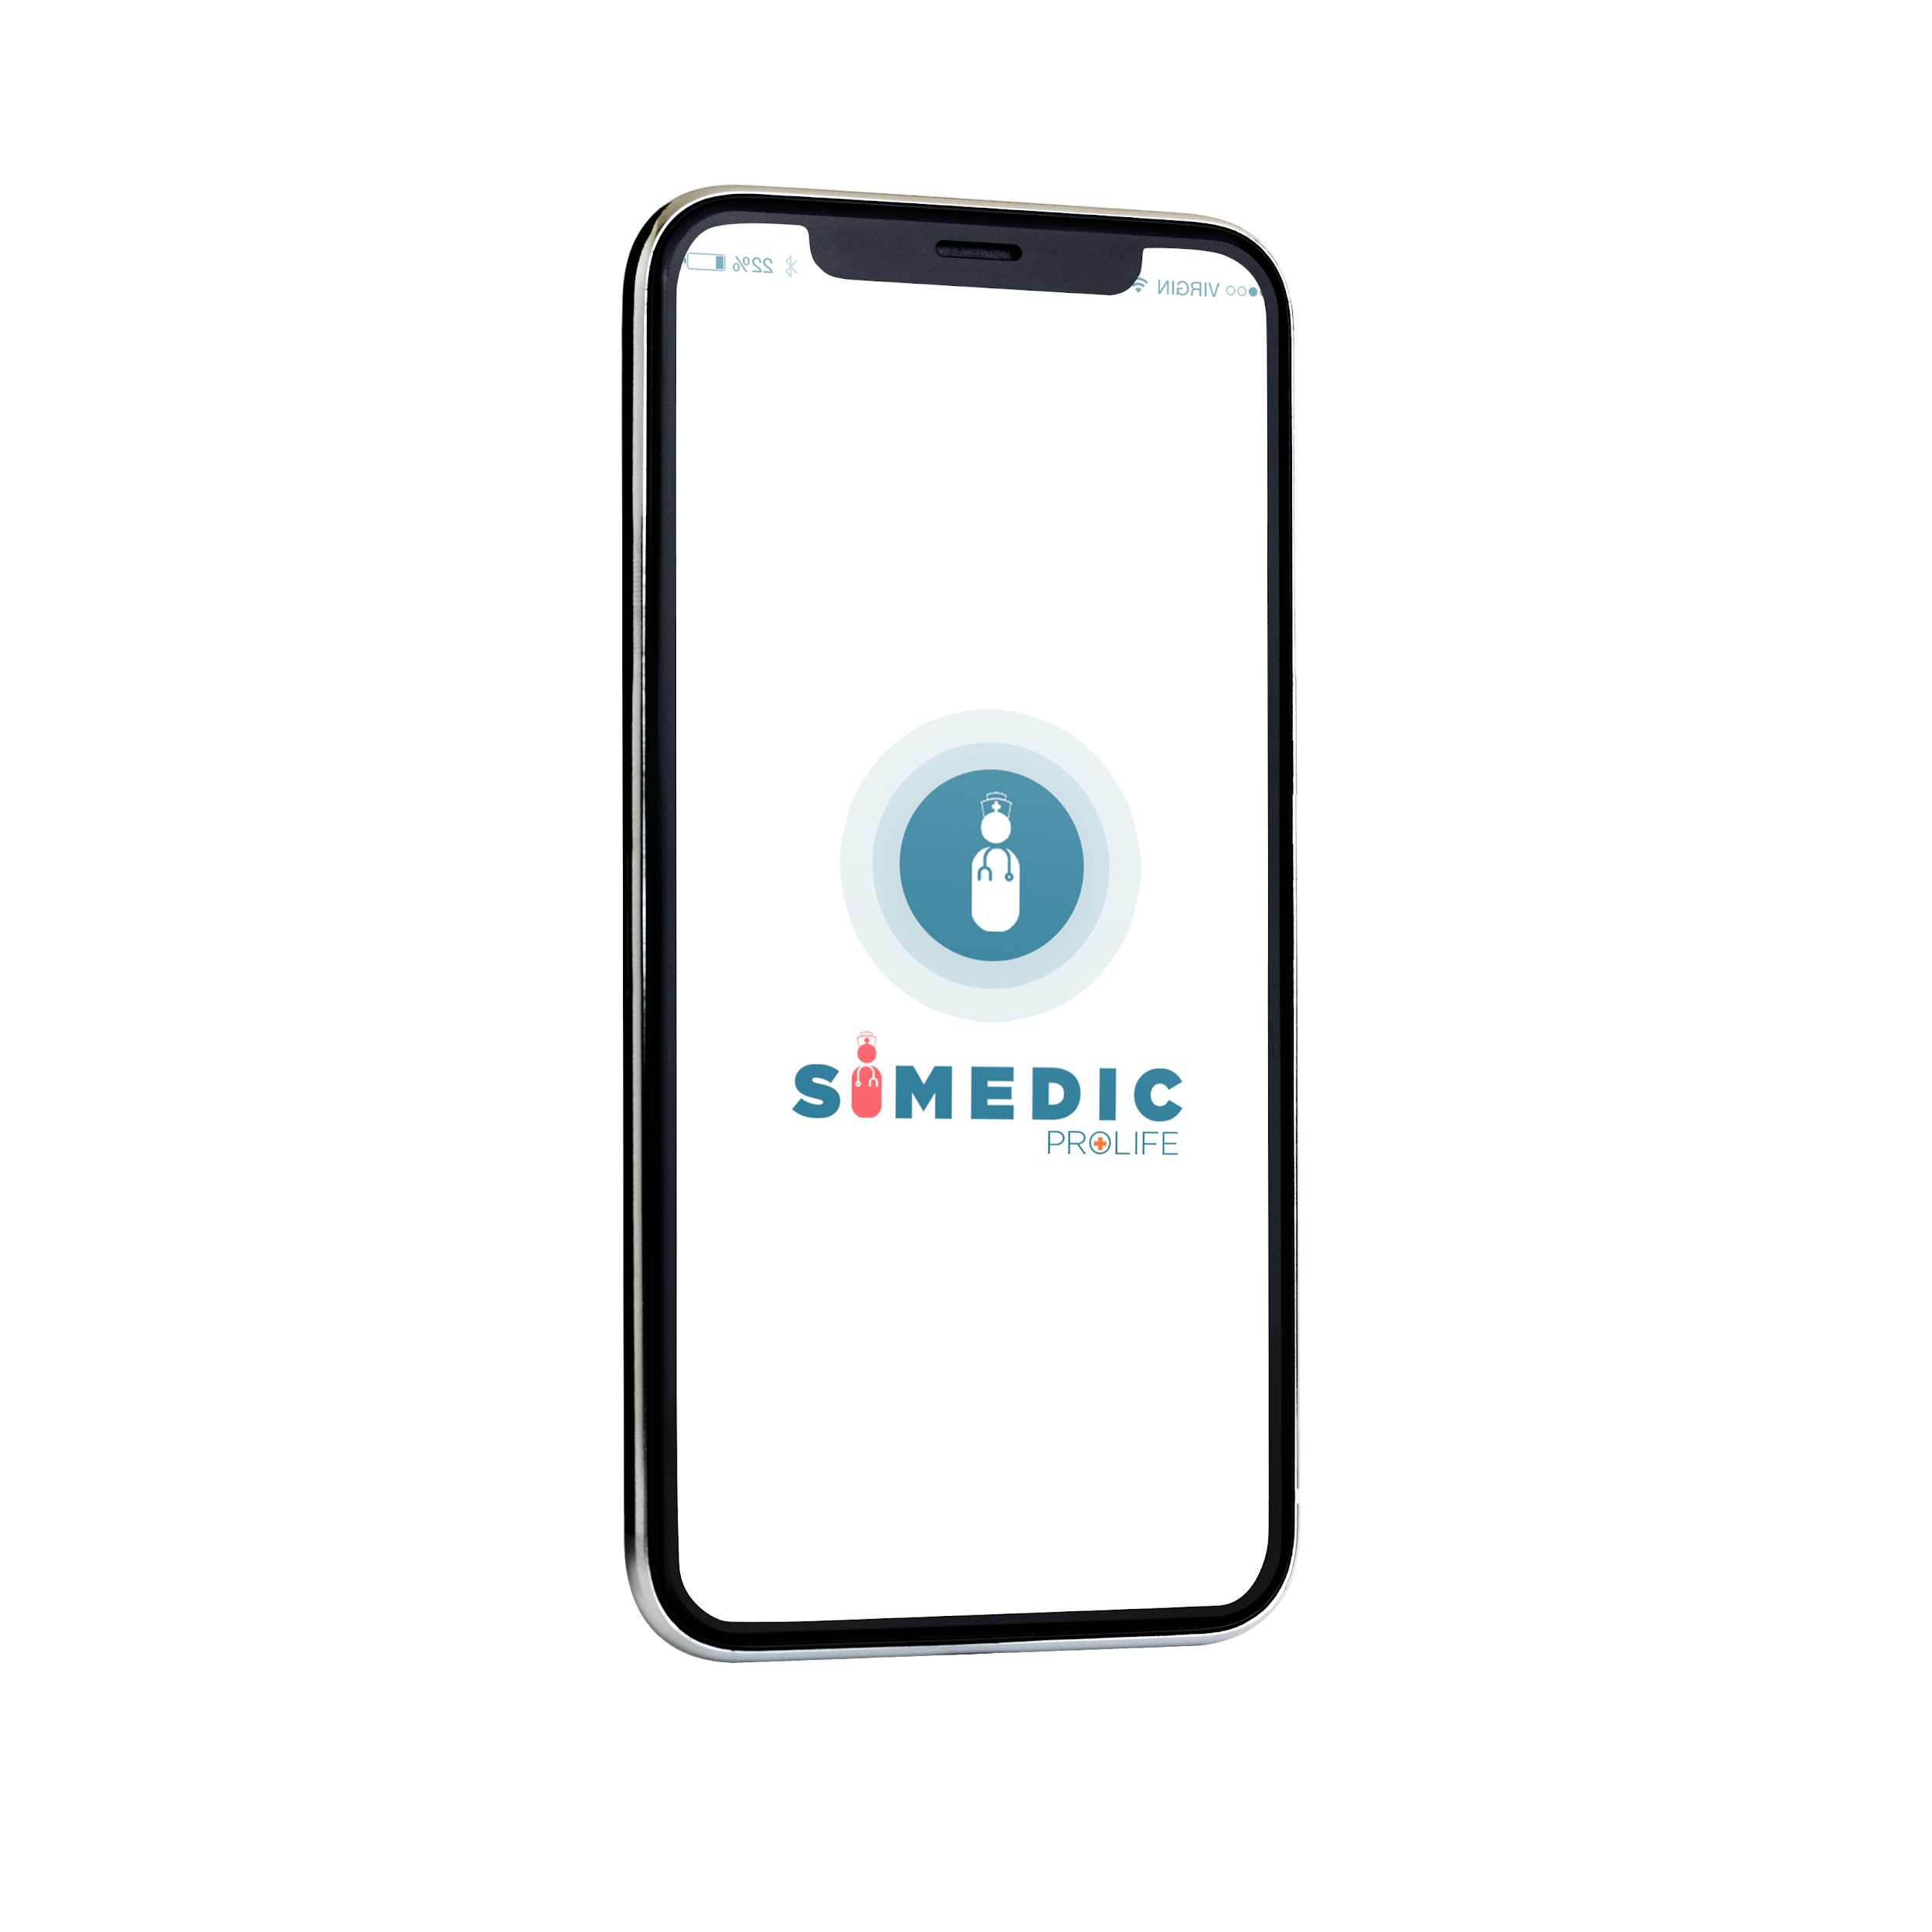
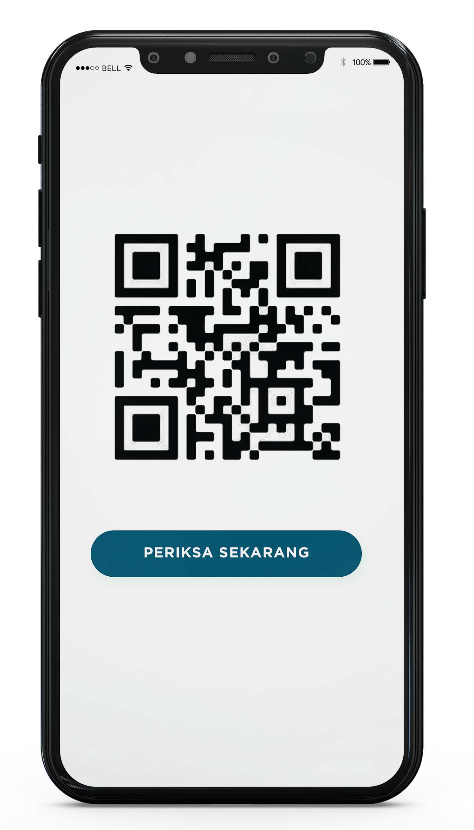
SIMEDIC COVID
The Innovations for Covid-19 test services focus on Registrations and Nakes administrations. Without install apps just scan and test it!

Slide 14
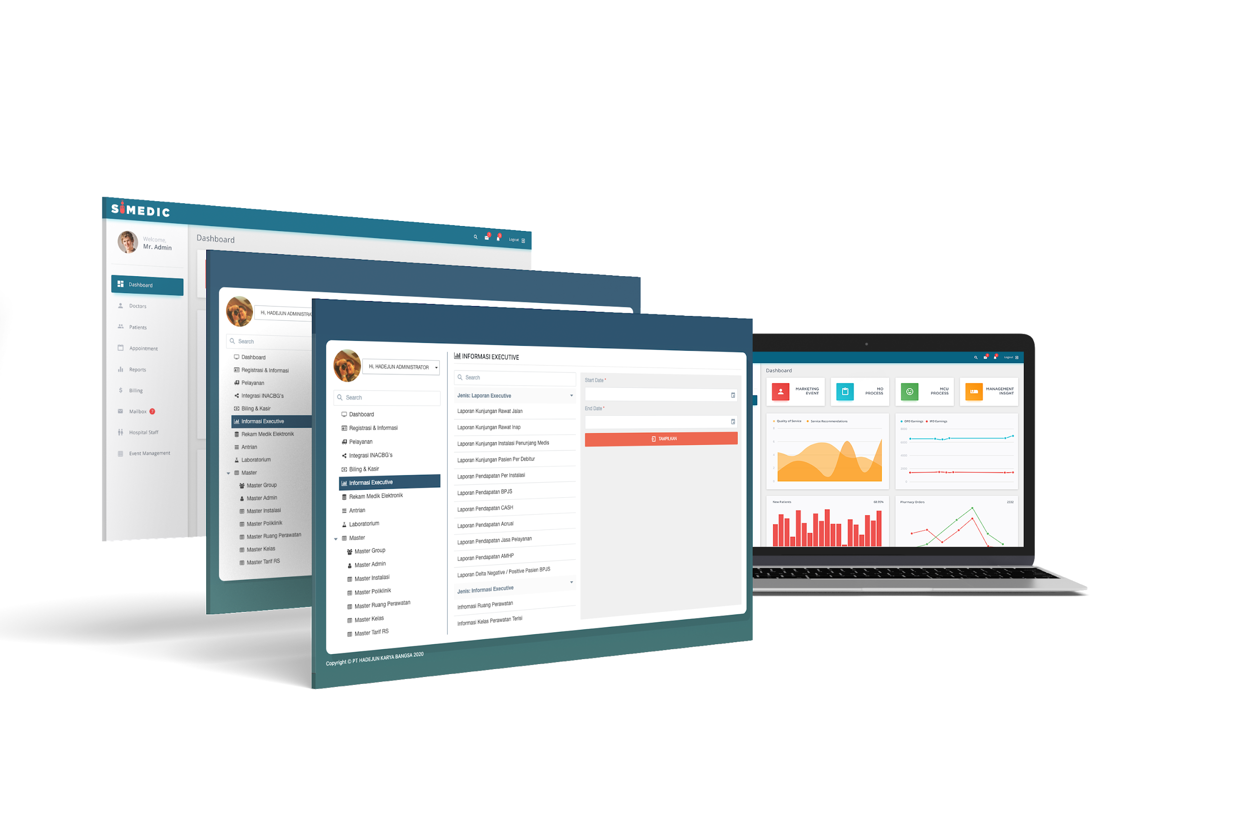
SIMEDIC LAB
The key innovations for reading lab system to export result in dashboard. All simedic driver can mutual connection with dashboard product Simedic

Slide 15

SIMEDIC IOT
one stop solution for device health connection. With this driver the reslut of lab can mutual connection with all dashboard Simedic product

Slide 16
OUR HISTORY

Slide 17



Our History To Create Legacy..
6 Years
10 Years
2010
2020
2004
From year to year demand for software medical began to increased and Mr. Daeng Amry continues to create innovate for medical personnel by creating APIK, & DINSLAB software
Mr. Daeng Amry realizes that creating many innovations cannot be personal. In 2020, finally Mr. Amry collaborated with Mr. Hasbi, and
Mr. Juan as the founder of a patented software innovation called Simedic under legal PT. Hadejun Karya Bangsa
Started by a Mr. Daeng Amry who made software for clinic in the Jakarta Area named Simedic & MIS. And then Simedic become commercialized by personally to many clinics in Indonesia

Slide 18




A Good Evolutions For Best Innovations..
2
0
0
4
2
0
2
0
More than 16 years we innovate and continue to develop
Simedic
Apik
Legal Corporations
& Brand Software
Dinslab

Slide 19
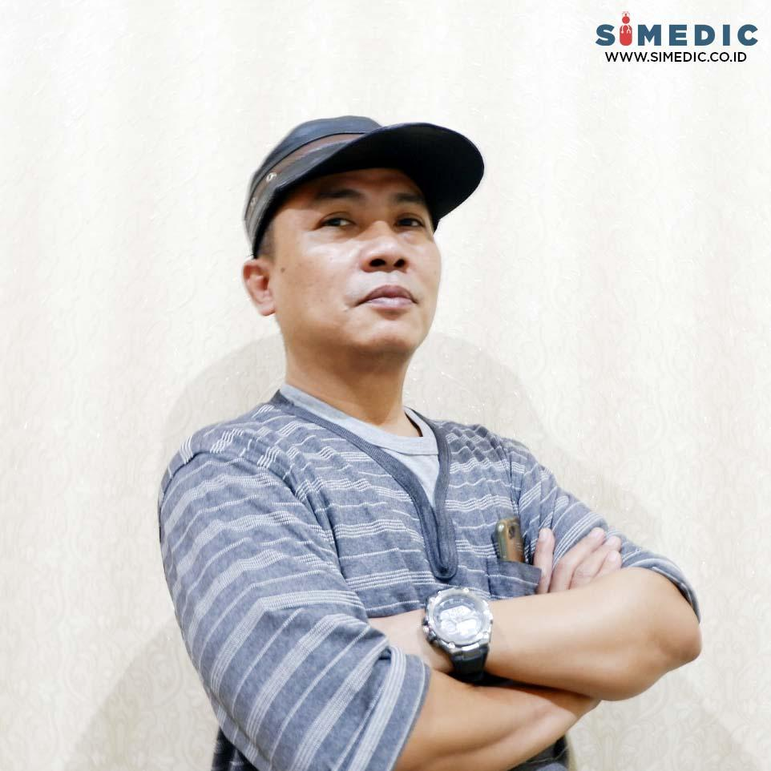
From the one become the greatest..
Mr. Daeng Amry is Founder and CEO of PT. Hadejun Karya Bangsa. Familiar with Daeng's name and persona have been popular among the medical services in indonesia since 2004 as the creator of many software developement innovations such as SIMEDIC (Sistem Informasi Medical Chek Up), DINSLAB (Data Instrumen Laboratorium), APIK (Aplikasi Inhouse Klinik), & MIS (Medical Informasi Sertifikat). As a strong persona finally Mr. Daeng decided to raise innovation in a single software development company in 2020 by inviting Mr. Hasbi and Mr. Juan as a founder in one organization PT. Hadejun Karya Bangsa to create the Next Simedic as a signature software for all types of medical services.
Daeng Amry
Founder & CEO
Founder story..

Slide 20
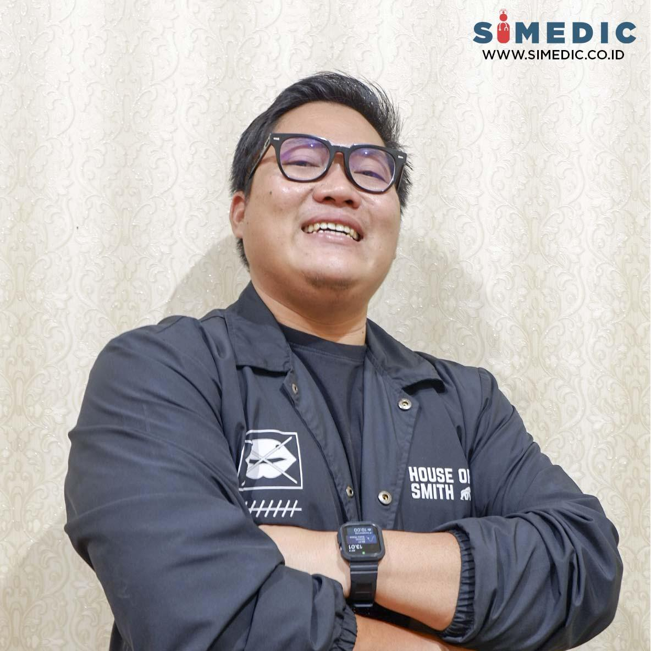
From nothing to something..
Mr. Hasbi Nurhaqi is an IT professional has created many applications and software since 2017 such as PIKO (financial technology application), AGILE (PPOB Biller Software), BNI Syariah Back End Portal, LIS System and BOSSKU application. Having business logic and IT makes Mr. Hasbi excited to create some innovation and then becomes one of the founders who serves his skills for PT. Hadejun Karya Bangsa with Mr. Daeng and Mr. Juan for the next Simedic software.
Hasbi Nurhaqi
Founder & CTO
Founder story..

Slide 21
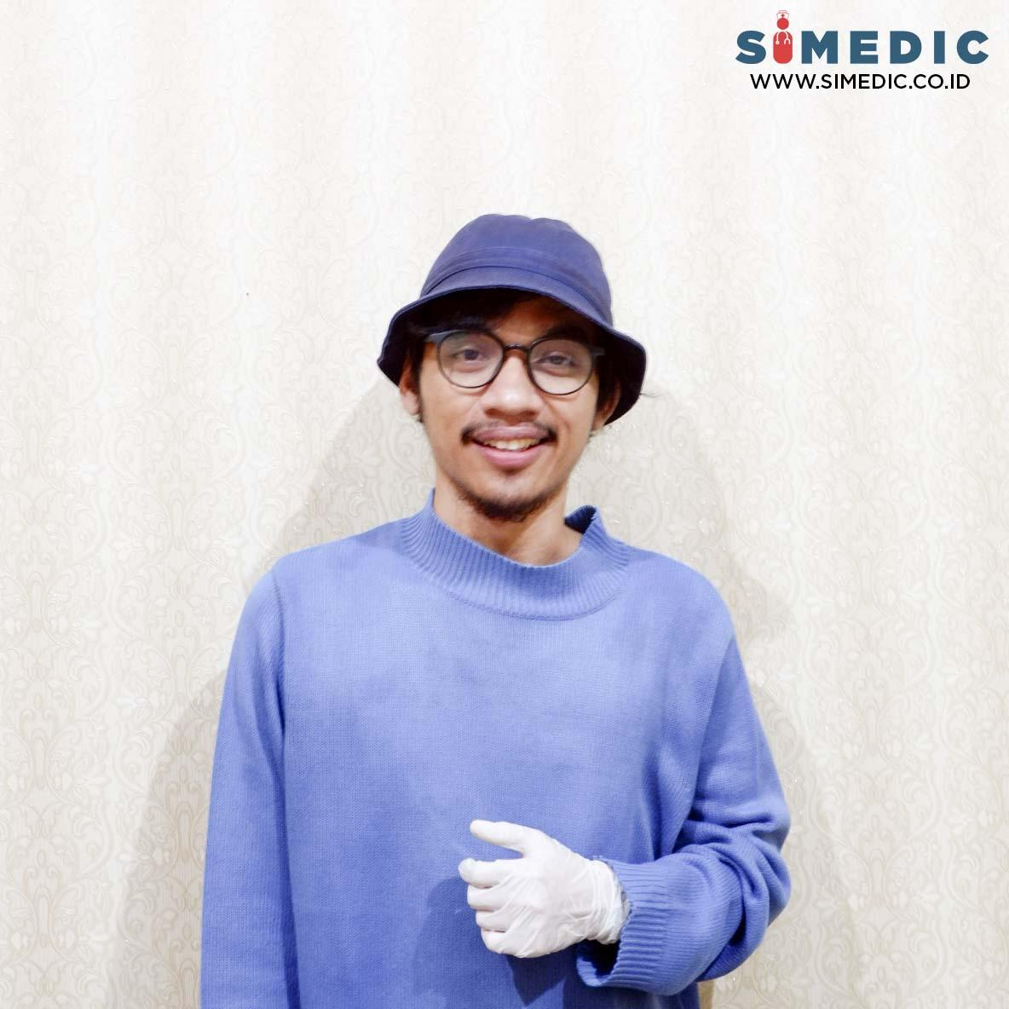
A Journey so far..
Has a lot of experience in the start-up world as a content creator and brand consultant. Mr.Juan has made many conceptual ideas in building a brand starting from Octopus Agency, Bossku.id, and Watch Your Hands. Now choosing to focus on building a software development company with Mr.Hasby and Mr.Daenk in Hadejun Karya Bangsa because he has the same vision in advancing the healthcare industry in Indonesia.
Juan
Founder & CMO

Slide 22
Our path of destination..
Motto
Vision
Mission
SOLVING the problem with technology and innovations for better medical service
INTEGRATIONS MEDICAL with single line system is a key to create software efective & efficient
DOING INNOVATIONS COMPREHENSIVE because we are the greatest Software Company For Future Health Service
S
IME
DIC

Slide 23
OUR SERVICES

Slide 24
Our Services
Software Development
Technology Consulting
Combining tech expertise and industry-specific knowledge, Itransition develops diverse custom solutions for small, medium-sized and enterprise-grade businesses.
Services help you focus on what you really need and align technology, operational and financial objectives.
Apps Development
Quality Assurance
Mobile software is the cornerstone of any modern business. Hadejun has extensive experience creating innovative mobile apps with different technology stacks.
We deliver independent QA services for any third-party software solution to give you better control of the quality, help evaluate the product’s and give you valuable insights into end user

Slide 25
CONTACT US

Slide 26
HALAMAN INI DIHIDE MUNCUL KETIKA ORANG KETIK MENU CONTACT. Datanya dikirim ke email: karyahadejun@gmail.com

